Slide 1
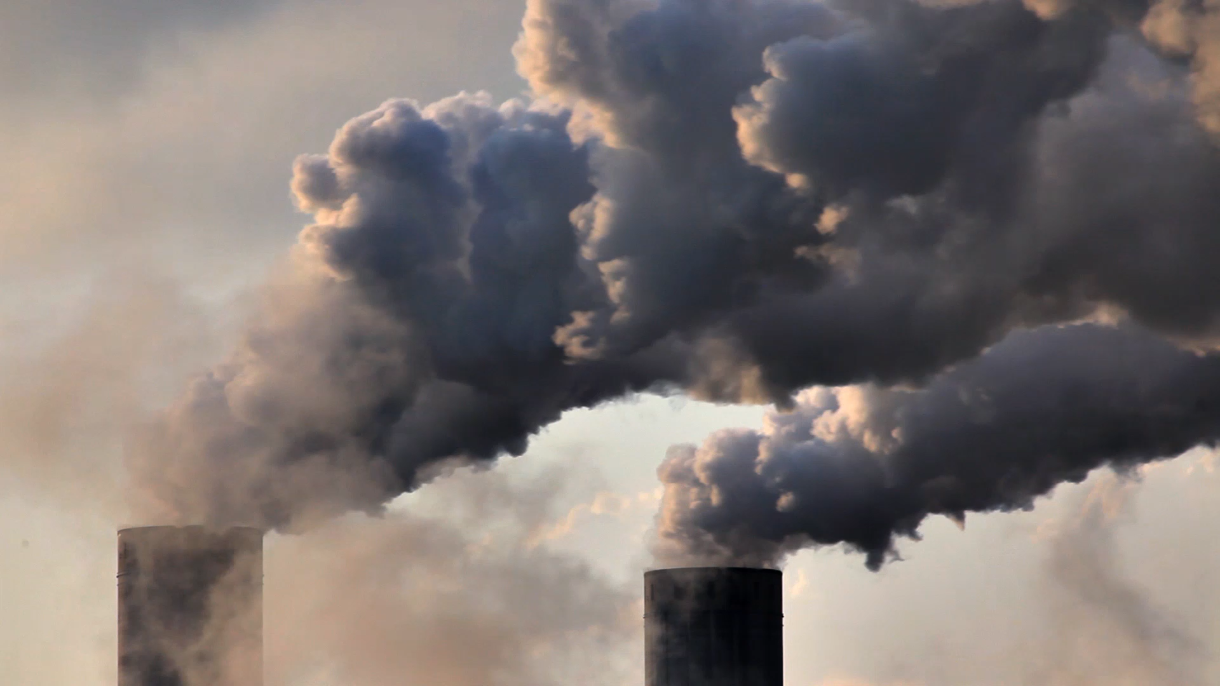
Visualizing Air
and the Pollutants it contains
DS612 Interactive Data Visualization
Course Project
GROUP 11

Slide 2
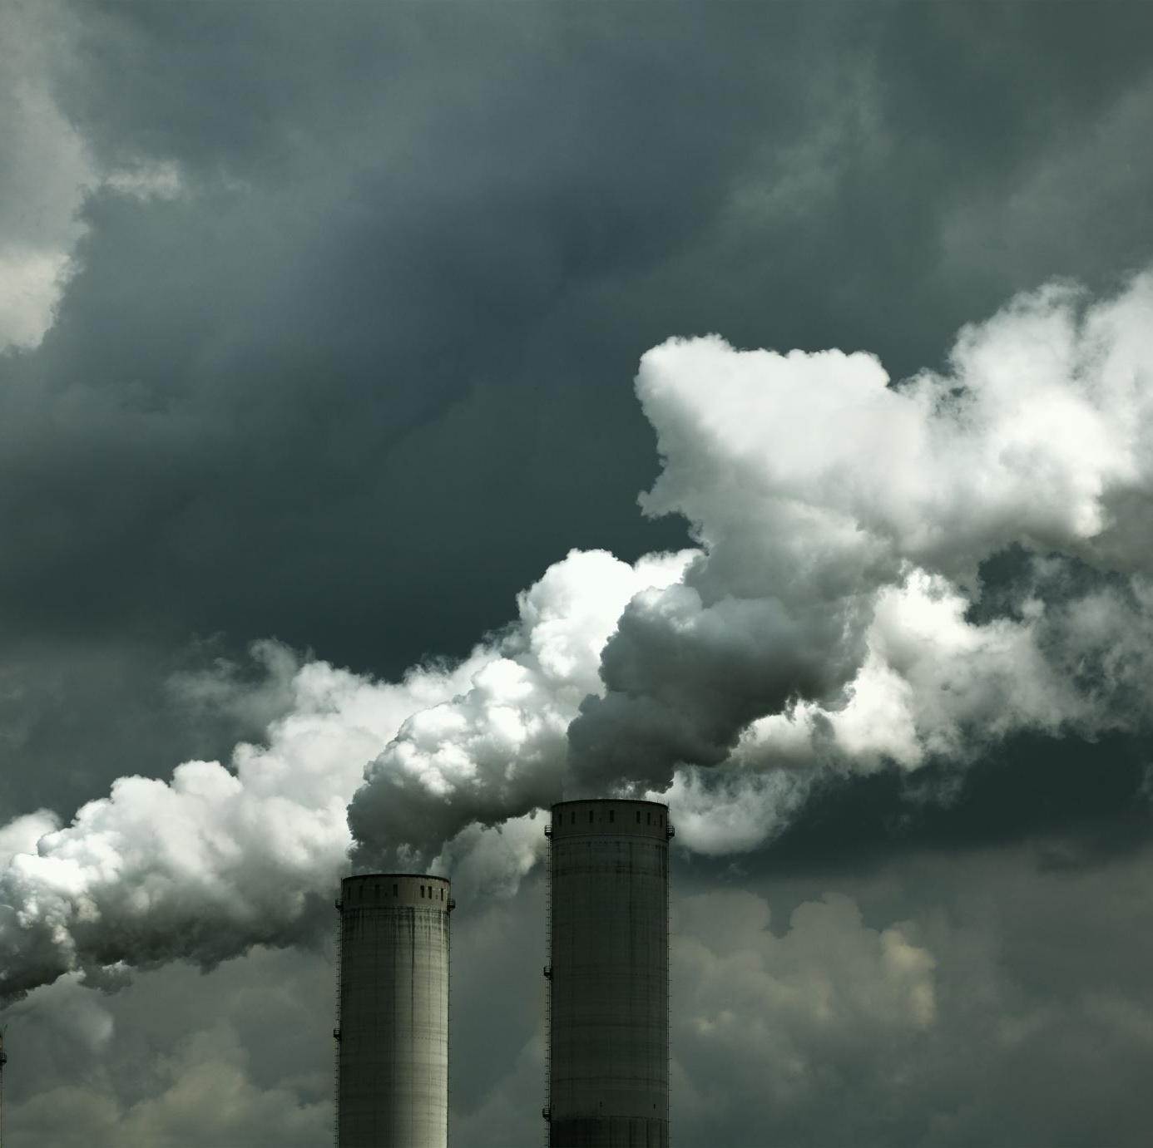
Foreword
Air pollution remains a major public health concern, especially in urban areas where human activity and atmospheric conditions vary significantly throughout the day and across seasons.

Slide 3
Foreword
Air pollution remains a major public health concern, especially in urban areas where human activity and atmospheric conditions vary significantly throughout the day and across seasons.

Slide 4
The main concerns:
Understanding the air pollution patterns is imperative to controlling the rise of air pollution.
Monitoring and analyzing air quality data has become essential for policymakers, researchers, and the public to take informed actions.
Urban settings and human activities are major contributors to rising air pollution.

Slide 5
The main concerns:
Understanding the air pollution patterns is imperative to controlling the rise of air pollution.
Monitoring and analyzing air quality data has become essential for policymakers, researchers, and the public to take informed actions.
Urban settings and human activities are major contributors to rising air pollution.

Slide 6
The main concerns:
Understanding the air pollution patterns is imperative to controlling the rise of air pollution.
Monitoring and analyzing air quality data has become essential for policymakers, researchers, and the public to take informed actions.
Urban settings and human activities are major contributors to rising air pollution.

Slide 7
The main concerns:
Understanding the air pollution patterns is imperative to controlling the rise of air pollution.
Monitoring and analyzing air quality data has become essential for policymakers, researchers, and the public to take informed actions.
Urban settings and human activities are major contributors to rising air pollution.

Slide 8
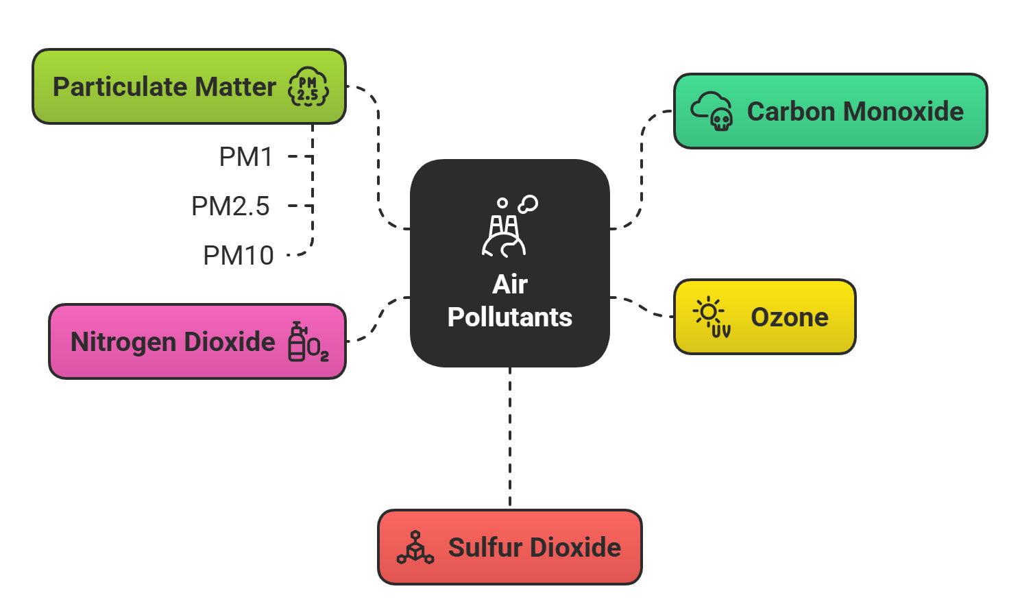
The pollutants found in air:

Slide 9
The pollutants found in air:

Slide 10
What we will focus on:
Major cities will have higher pollution levels than smaller towns
Hypothesis 1
Seasonal Variations in Air Quality due to prolonged exposure
Hypothesis 2
Traffic and Urban activity drive pollution peaks during Rush Hours
Hypothesis 3

Slide 11
What we will focus on:
Major cities will have higher pollution levels than smaller towns
Hypothesis 1
Seasonal Variations in Air Quality due to prolonged exposure
Hypothesis 2
Traffic and Urban activity drive pollution peaks during Rush Hours
Hypothesis 3

Slide 12
What we will focus on:
Major cities will have higher pollution levels than smaller towns
Hypothesis 1
Seasonal Variations in Air Quality due to prolonged exposure
Hypothesis 2
Traffic and Urban activity drive pollution peaks during Rush Hours
Hypothesis 3

Slide 13
What we will focus on:
Major cities will have higher pollution levels than smaller towns
Hypothesis 1
Seasonal Variations in Air Quality due to prolonged exposure
Hypothesis 2
Traffic and Urban activity drive pollution peaks during Rush Hours
Hypothesis 3

Slide 14
How we will proceed:
Understanding the pattern of air pollution across:

Slide 15
How we will proceed:
Understanding the pattern of air pollution across:
Different locations around the world, focusing on urban/ sub-urban settings, and difference in types of pollutants based on location.

Slide 16
How we will proceed:
Understanding the pattern of air pollution across:
Different locations around the world, focusing on urban/ sub-urban settings, and difference in types of pollutants based on location.
Different time granularity and how the levels of pollutants change over different time periods. i.e hours of day (day/night), days of week (weekdays/weekends), seasons in an year (summer, monsoon, post-monsoon, winter) and also over multiple years.

Slide 17
How we will proceed:
Understanding the pattern of air pollution across:
Different locations around the world, focusing on urban/ sub-urban settings, and difference in types of pollutants based on location.
Different time granularity and how the levels of pollutants change over different time periods. i.e hours of day (day/night), days of week (weekdays/weekends), seasons in an year (summer, monsoon, post-monsoon, winter) and also over multiple years.

Slide 18
Dataset Overview:
Source: OpenAQ dataset
Key fields:
parameter (pollutant), value, datetime, city, location
Data Enrichment:
Extracted hour, day, month, season
Derived pollution categories where necessary

Slide 19
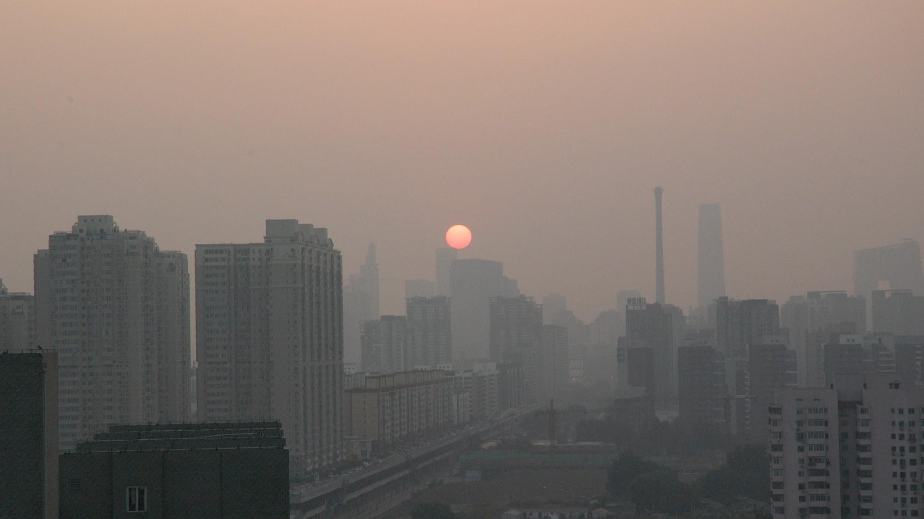
Hypothesis 1
Major cities will have higher pollution levels than smaller towns

Slide 20
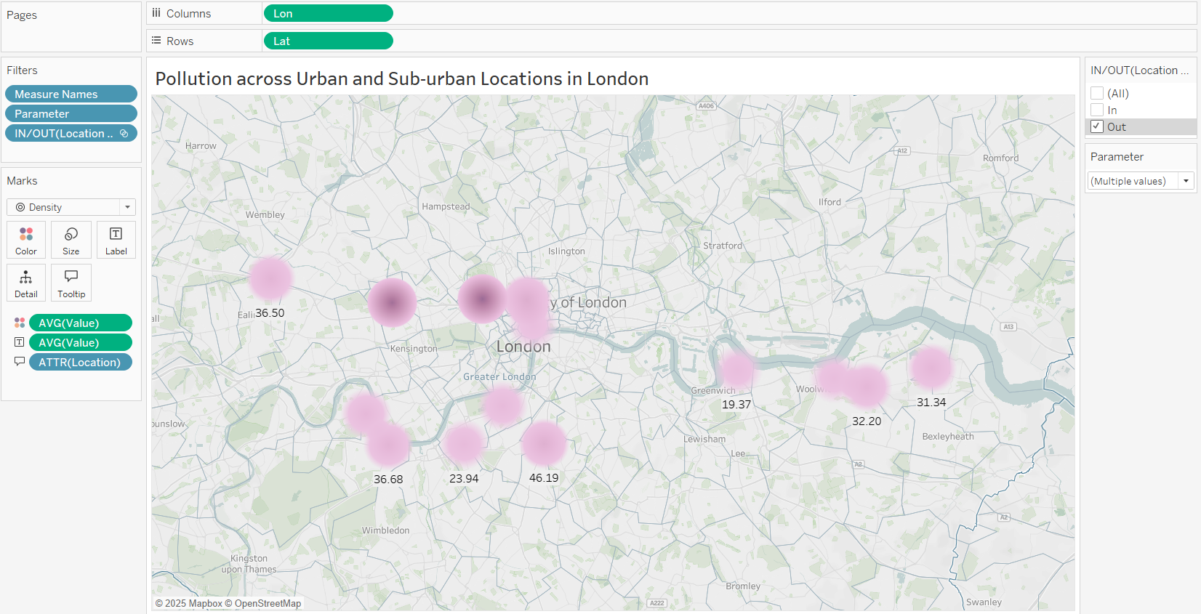
And how the pollution increases in the urban areas

Slide 21
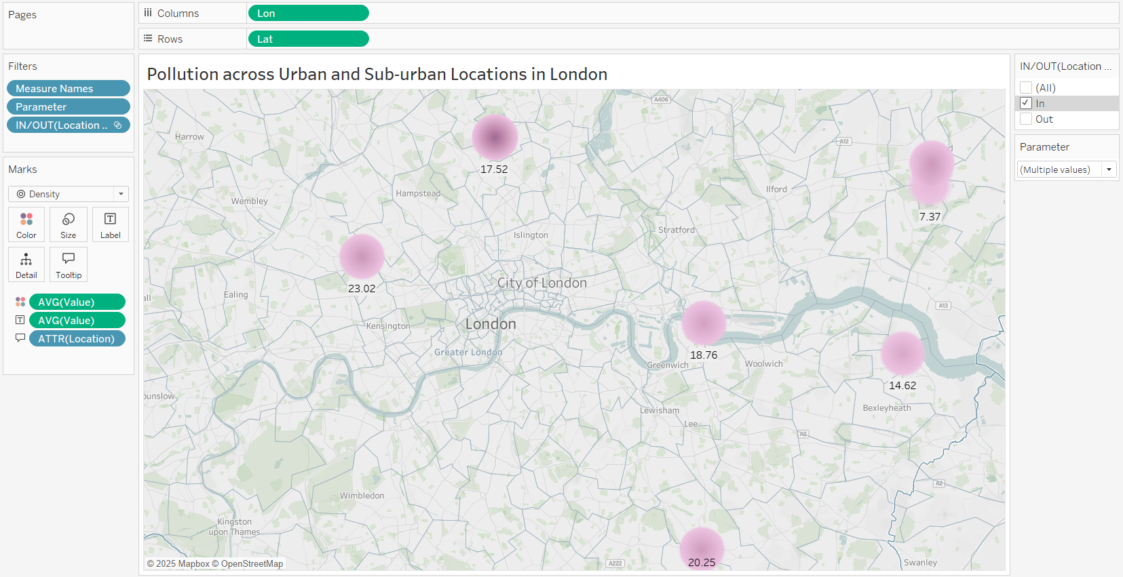
A look at sub-urban areas in London city

Slide 22
Pollution Factors: Urban vs SubUrban (CO, NO₂, O₃)
Factor | Urban | Sub-urban
CO (Carbon Monoxide) | High due to vehicle congestion and incomplete fuel combustion in dense traffic zones | Low due to fewer vehicles and minimal industrial activity
NO₂ (Nitrogen Dioxide) | Elevated from diesel vehicles, heating systems, and high traffic volume | Lower due to reduced vehicle emissions and cleaner environment
O₃ (Ozone) | Lower because NO reacts with O₃, breaking it down in high-traffic zones (ozone scavenging) | Higher due to more sunlight, cleaner air, and lower NOx, favoring ozone formation
Visual Density (MAP) | Dense bright clusters indicating high pollution hotspots | Light or dispersed clusters showing lower pollution levels

Slide 23
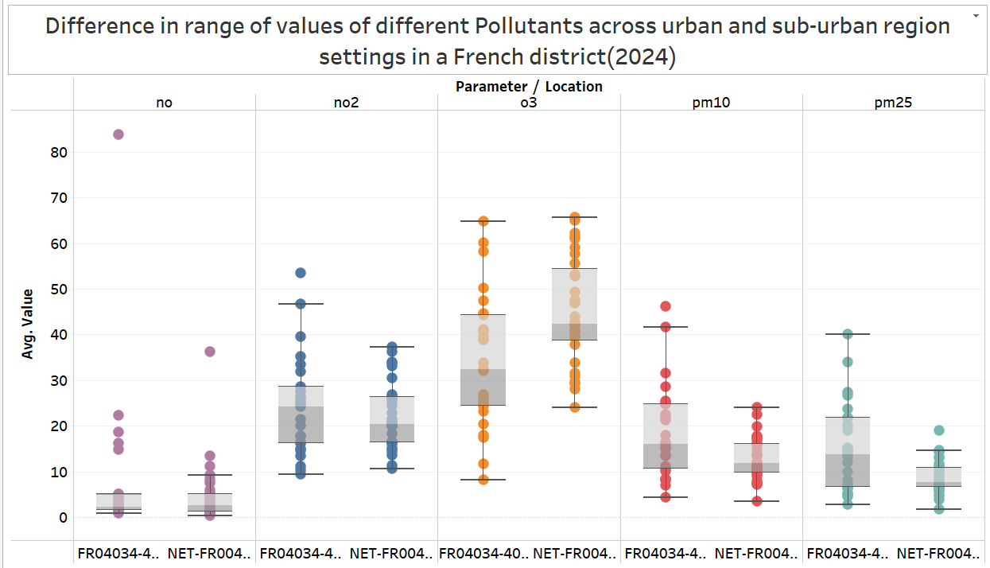
Pollutants vary across regions and its levels changes

Slide 24
Summary of Pollutant Levels Across French Districts
Pollutant | Main Source | High in Areas | Typical Region Type | Explanation
NO (Nitric Oxide) | Vehicle emissions (especially diesel) | Urban areas | Urban | High traffic and industrial zones lead to elevated NO levels.
NO₂ (Nitrogen Dioxide) | Combustion (vehicles, heating, industry) | Urban areas | Urban | Concentrated emissions from transport and buildings.
O₃ (Ozone) | Secondary pollutant (formed from NOx & VOCs in sunlight) | Suburban/Rural areas | Sub-urban/Rural | Formed downwind from cities; destroyed in urban areas due to reaction with NO.
PM10 | Dust, construction, wood burning, agriculture | Both | Both (Urban & Sub-urban) | Urban: construction/traffic dust; Sub-urban: agriculture, biomass burning.
PM2.5 | Fine particles from combustion (vehicles, heating) | Both, varies by season | Both | Peaks in winter due to heating (suburban) and year-round traffic (urban).

Slide 25
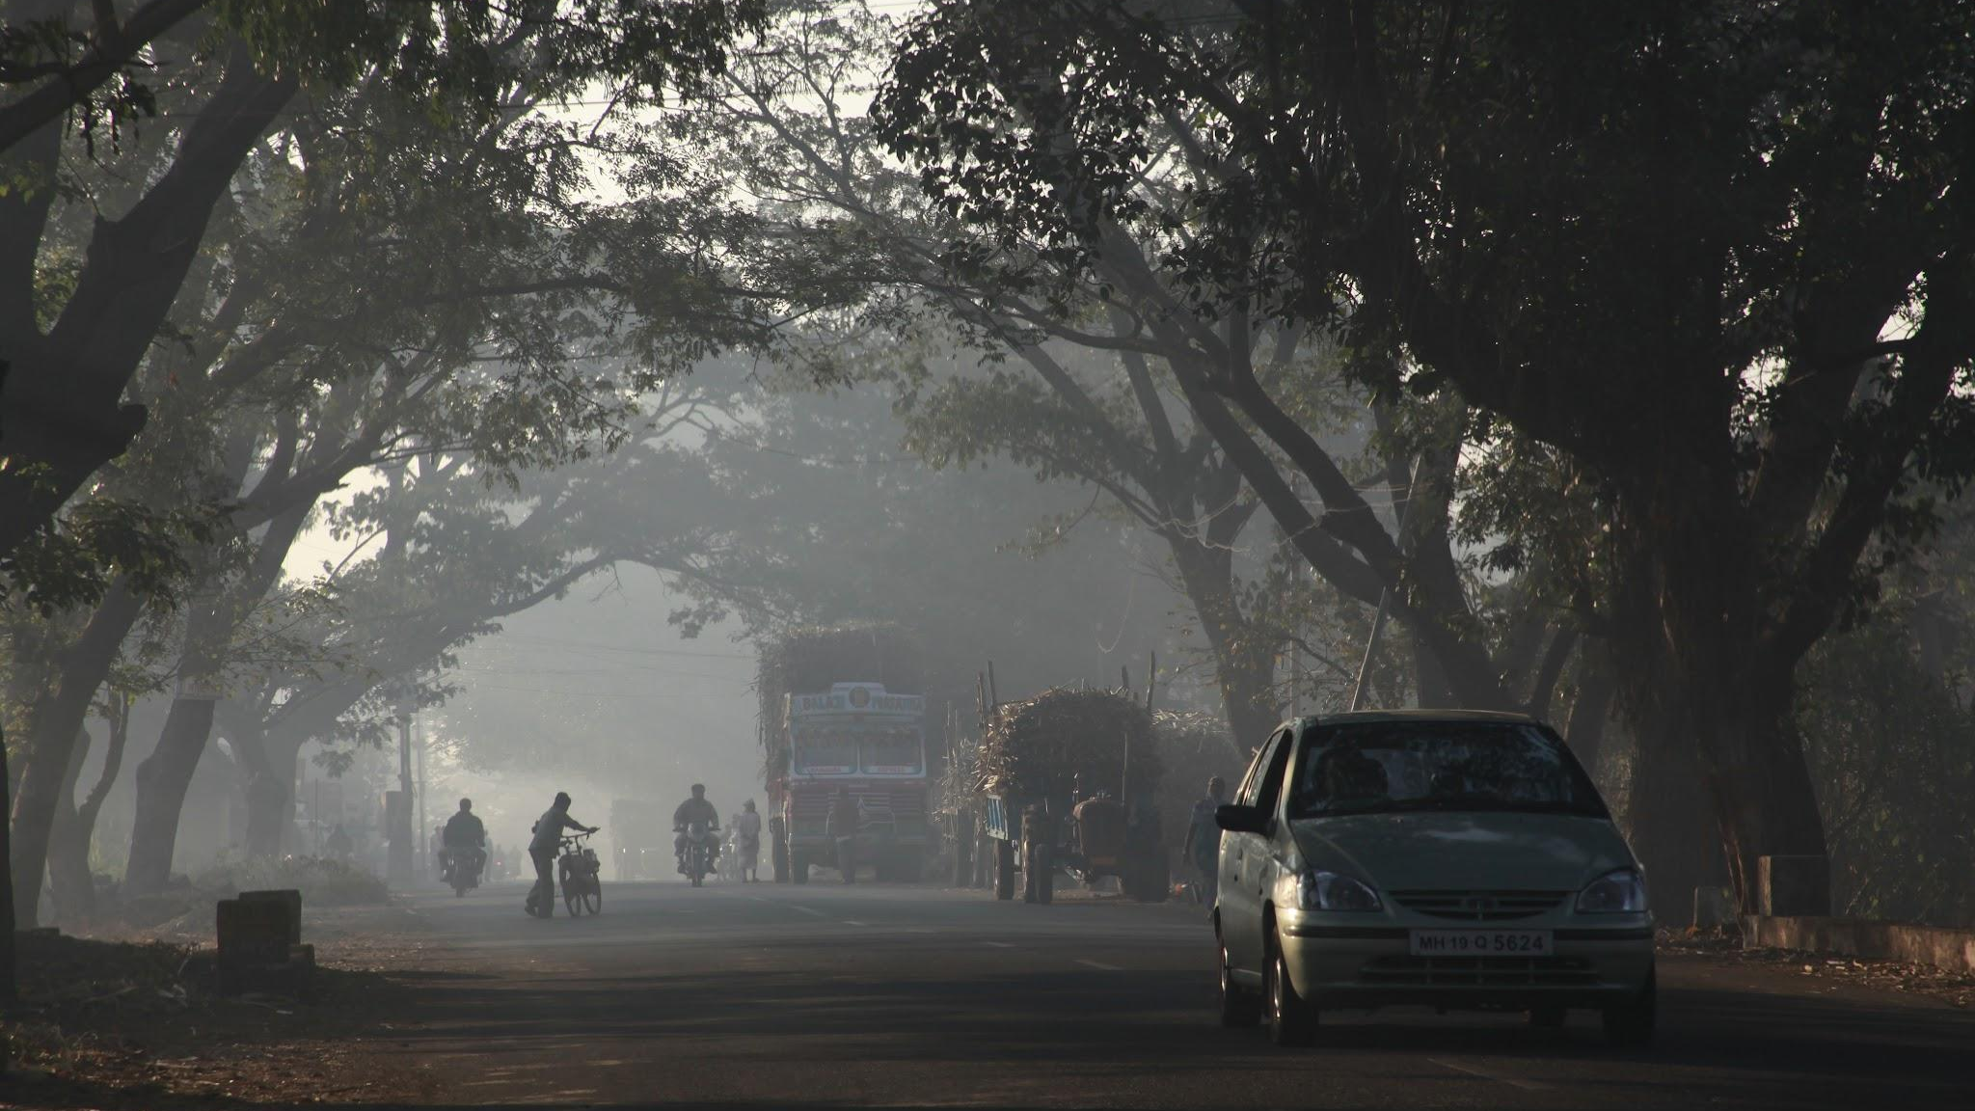
Hypothesis 2
Air Pollution will be higher during winter months than in summer months

Slide 26
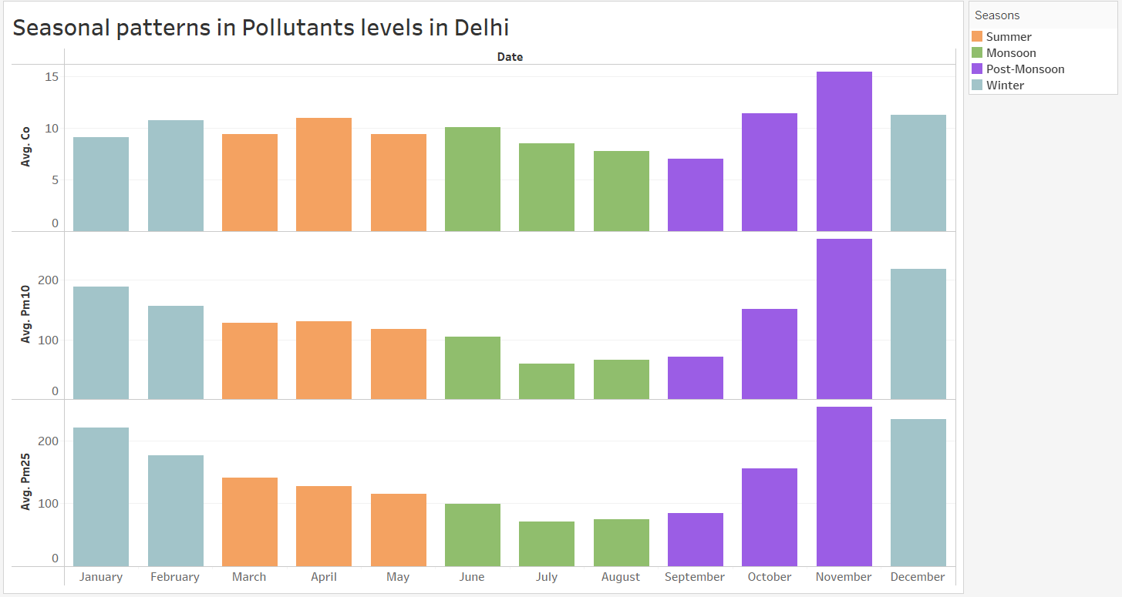
How pollution level changes through different seasons

Slide 27
Summary of the pollutants by every season:
Season | Main Pollutants | Comments
Winter | PM2.5, PM10, CO | Pollution trapped due to cold, low wind, fog, biomass burning
Summer | PM10 (Moderate) | Dust storms, drier air
Monsoon | All pollutants low | Rain scrubs the air, best air quality
Post-Monsoon | PM2.5 (Sharp spike), CO, PM10 | Stubble burning (Oct–Nov), Diwali (fireworks), stagnant conditions

Slide 28
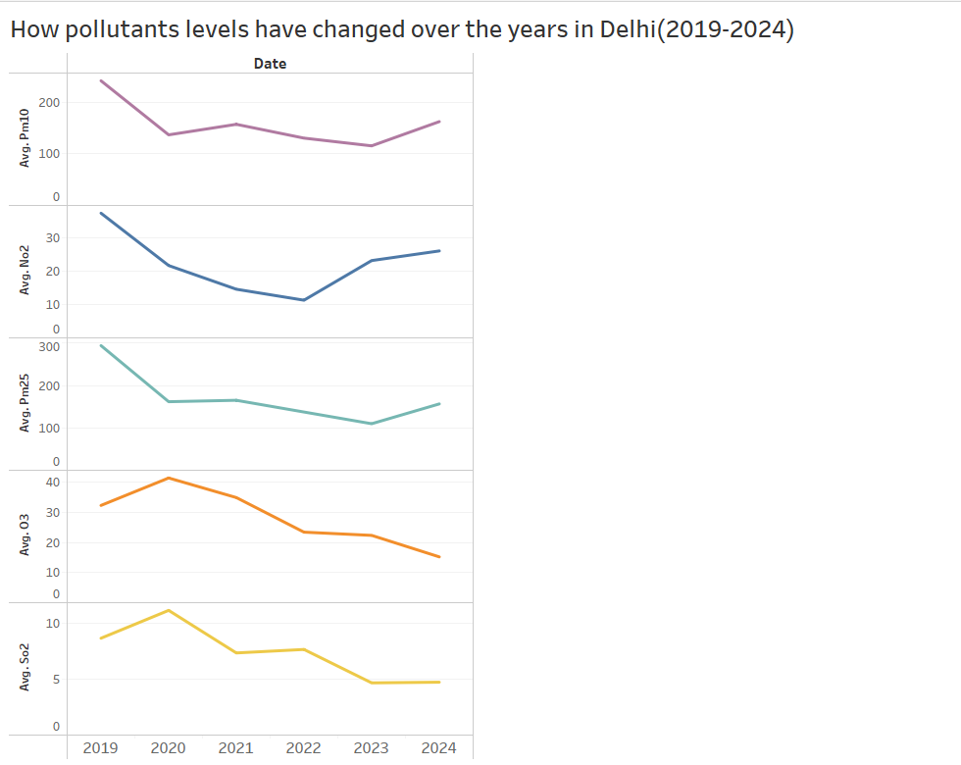
Pollution trends over the years in Delhi (2019-2024)
Explanation
- Drop due to halted construction & transport during lockdown (2020–21) - Increase from resumed construction, road dust, and industrial activity
- Traffic emissions dropped sharply during lockdown - Rise linked to increased vehicle use post-2022
- Lockdowns reduced vehicular and industrial emissions - Rise from winter pollution, stubble burning, and traffic
- Reduced NOx & VOCs due to lower emissions - Stable sunlight levels limited ozone formation
- Shift to cleaner fuels (BS-VI norms from 2020) - Reduced coal and industrial SO₂ emissions

Slide 29
Key Insights:
From the visualization, we can see a significant dip during the years (2019 - 2022) due to “COVID-19”.
But the major change was in NO₂ (majorly caused by vehicle emission), and as there was less commute during that time and WFH(work from home) measures imposed by companies, which caused a major dip in NO₂ values.

Slide 30
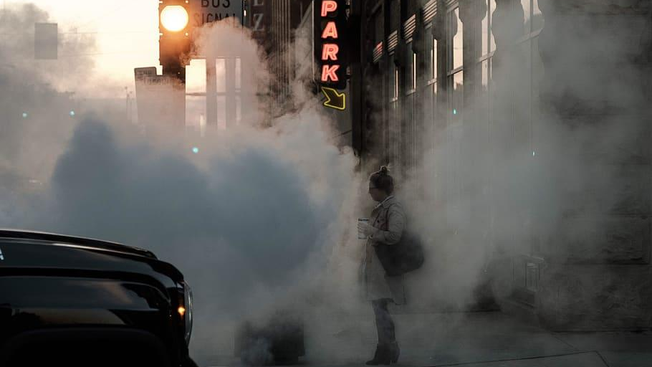
Hypothesis 3
Pollution levels will show daily patterns with peaks during morning and evening rush hours

Slide 31
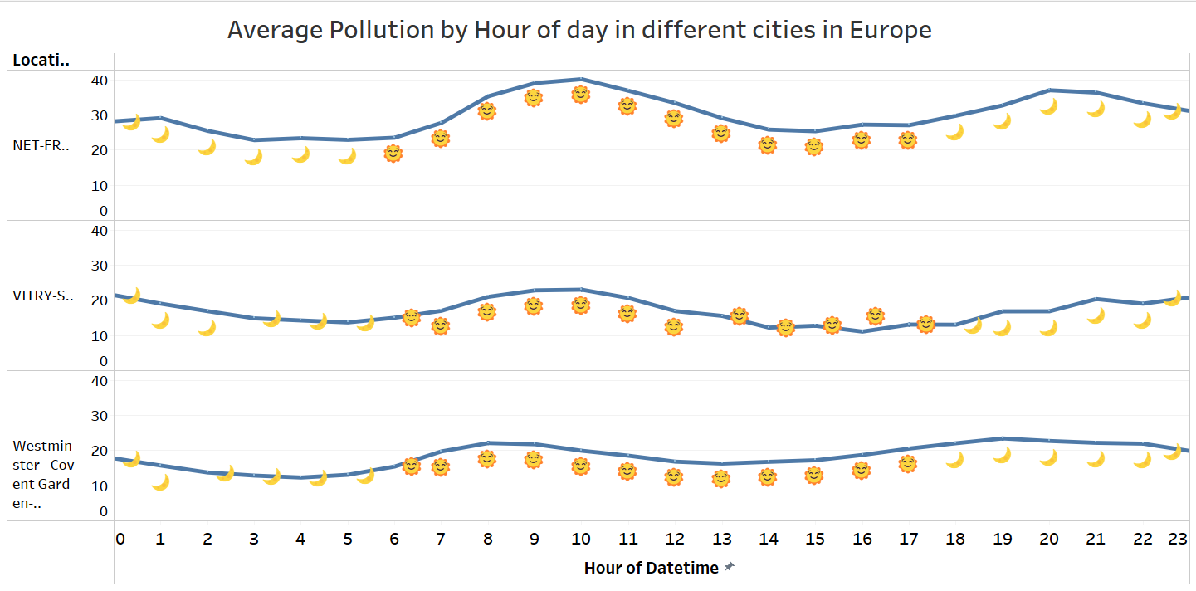
Daily trends in pollution levels across different cities in Europe

Slide 32
Key Insights:
It can be seen that patterns throughout the day is very similar in different cities in Europe such as major cities like London & Paris and suburban town Vitry-sur Seine, generally due to similar working culture & geography.
There is a clear spike in pollution during peak commute times (7-12 am) and (5-9 pm).

Slide 33
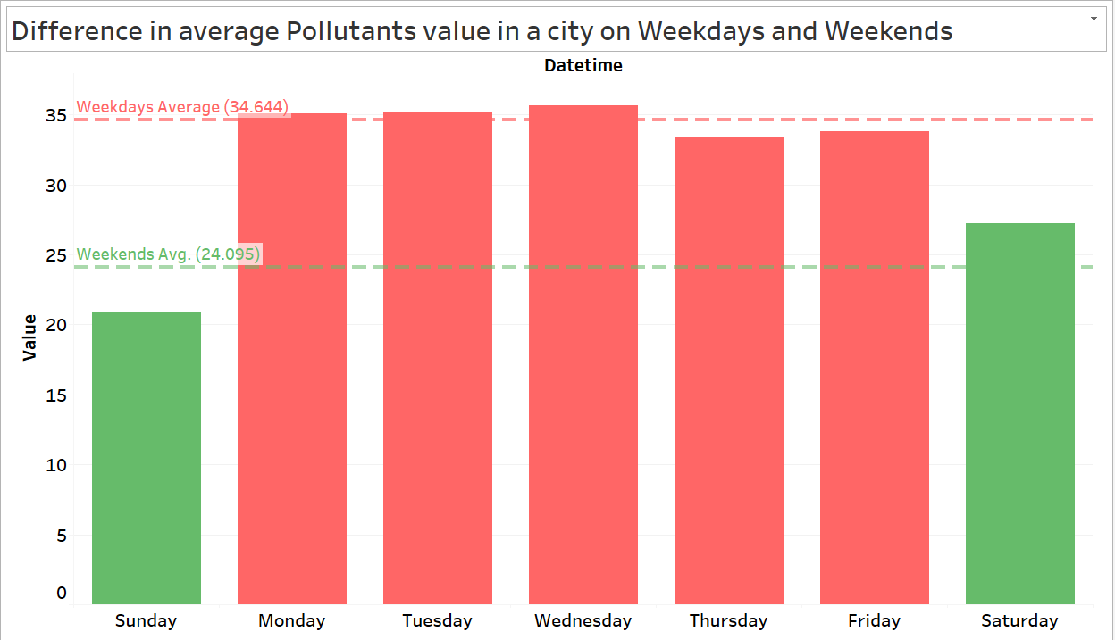
A look at sub-urban areas in London city

Slide 34
Key Insights:
Pollution levels throughout the weekdays are seen to be much higher on average than how much it is on the weekends.
As on weekends most of companies and industries are closed so there we can see a clear dip in air pollution.

Slide 35
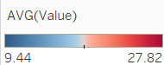
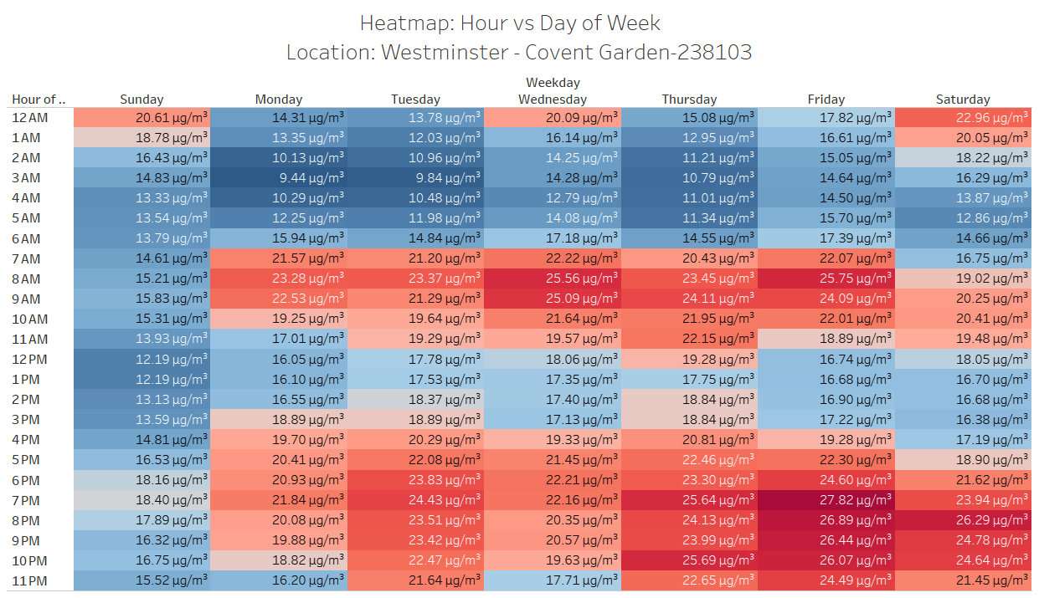
Heatmap: Hour vs Day of Week

Slide 36
Key Insights:
Weekdays tend to have higher pollution concentration than weekends and in peak hours of commute on weekdays, pollution concentration is the highest.
During weekends pollution spikes tend to be during late evening hours as most people go for an outing in late evening.
There is stark difference between the pollutions levels on weekends and weekdays and the hours in those days.

Slide 37
Conclusion:
While the understanding of air pollution has increased spell bound over the years, these insights into the patterns is a clear indicator as to what should be done to prevent the rise of air pollution.
The analysis of air pollution trends can be seen to follow certain patterns which can be justified using scientific explanations.
Across different time granularities and across different locations and region scopes, certain hypotheses were found to be true.

Slide 38
Conclusion:
The analysis of air pollution trends can be seen to follow certain patterns which can be justified using scientific explanations.
While the understanding of air pollution has increased spell bound over the years, these insights into the patterns is a clear indicator as to what should be done to prevent the rise of air pollution.
Across different time granularities and across different locations and region scopes, certain hypotheses were found to be true.

Slide 39
Conclusion:
The analysis of air pollution trends can be seen to follow certain patterns which can be justified using scientific explanations.
Across different time granularities and across different locations and region scopes, certain hypotheses were found to be true.
While the understanding of air pollution has increased spell bound over the years, these insights into the patterns is a clear indicator as to what should be done to prevent the rise of air pollution.

Slide 40
Conclusion:
The analysis of air pollution trends can be seen to follow certain patterns which can be justified using scientific explanations.
Across different time granularities and across different locations and region scopes, certain hypotheses were found to be true.
While the understanding of air pollution has increased spell bound over the years, these insights into the patterns is a clear indicator as to what should be done to prevent the rise of air pollution.

Slide 41
Thank You!
Jalak Vyas (202418062)
Vedant Dave (202418014)
Kumar Sanskar (202418027)
Saarthak Jindal (202418046)

